Slide 1
Surface Crack Detection

Slide 2
Datasets
1. Context
Concrete surface cracks are major defect in civil structures
Crack detection plays a major role in the building inspection, finding the cracks and determining the building health.
Datasets link: https://www.kaggle.com/arunrk7/surface-crack-detection

Slide 3
Datasets
2. Content
The image data are divided into two as negative (without crack) and positive (with crack) in separate folder for image classification.
Each class has 20000 images with a total of 40000 images with 227 x 227 pixels with RGB channels.
No data augmentation in terms of random rotation or flipping or tilting is applied.
Datasets link: https://www.kaggle.com/arunrk7/surface-crack-detection

Slide 4
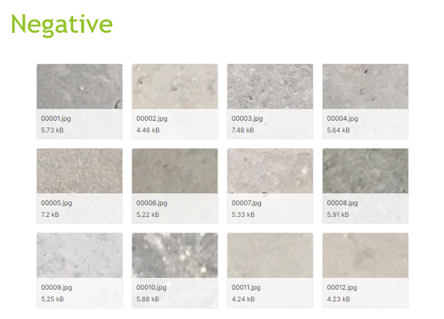
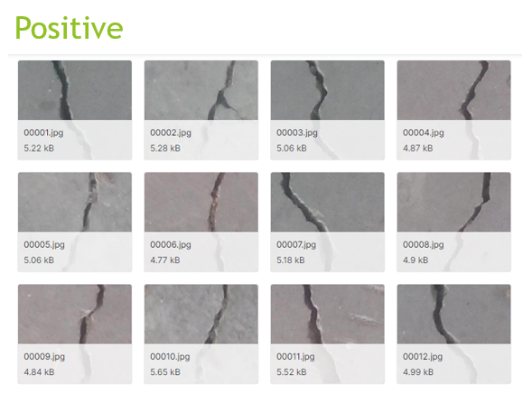
Model
I will be using a TensorFlow CNN to make my predictions

Slide 5
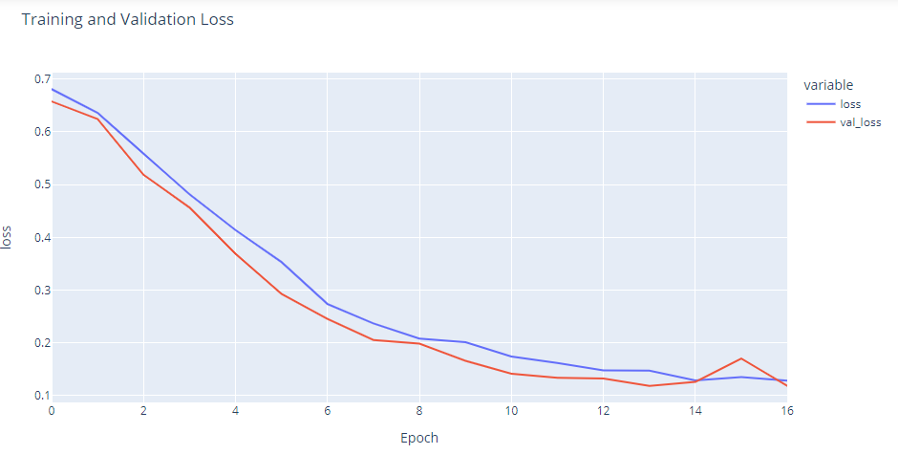
Plot Model

Slide 6
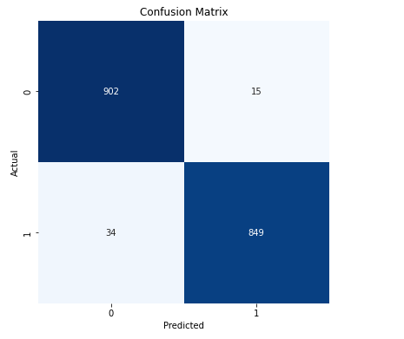

Evaluate Model

Slide 7
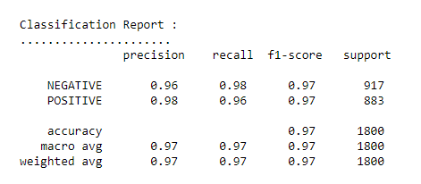
Classification Report

Slide 8
Thank you for watching

